Slide 1

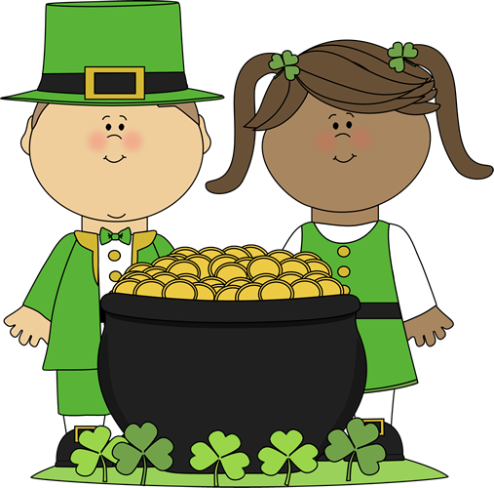


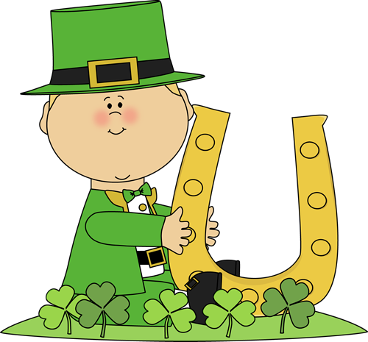








March 2018
2018
2017
BridgePrep Academy of Duval
Sunday | Monday | Tuesday | Wednesday | Thursday | Friday | Saturday
 |  |  |  | 1 Book Drive begins – drop off in front office | 2 Dr. Seuss B’Day Celebration | 3
4 Talent Show Registration 3/5 – 3/15 for $5 per act | 5 Krispy Kreme Fundraiser begins 3/5 – 3/26 | 6 FSA Writing Test 4th – 6th | 7 School Spirit Shirt Day Donut Sale - $1 | 8 RSVPs due today for next week’s activities | 9 NO UNIFORM $2 | 10
11 | 12 Muffins For Mom 9:30 – 11:30 a.m. | 13 Donuts For Dad 9:30 – 11:30 a.m. | 14School Spirit Shirt Day Donut Sale - $1 Ice Cream Social 1:30 | 15Family Night – Chili’s *20% donated to school | 16 Teacher Planning Day – No School | 17
18 | 19 | 20 | 21 | 22 | 23 | 24 Community Yard Sale - $10 per display area
25 | 26 Krispy Kreme Fundraiser money due today | 27 | 28 School Spirit Shirt Day Donut Sale - $1 | 29 Krispy Kreme certificate pick Spring Dance - $5 *5TH & 6th* | 30 No School – Spring Holiday | 31 Coming Up…Talent Show on 4/6
Our Mission Statement
BridgePrep Academy believes every child learns best in a safe, nurturing and stimulating environment where high academic expectations, self-esteem, good character and an appreciation for the arts are promoted. BridgePrep Academy’s mission is to provide a challenging academic curriculum that will encompass an enriched Spanish language program, technology and experiences that will enable students to develop in all areas.
BridgePrep Academy’s goal is to educate well rounded individuals and enable students
to reach their maximum potential.
Pre-Gala Ticket Sale
Adult: $20
Child $15
www.BridgePrepDuval.com
https://www.facebook.com/BridgePrepAcademyofDuval/
NO UNIFORM $2
Snack Sales
Book Fair Week
Spring Break
BridgePrep Academy
of Duval
6400 Atlantic Blvd
Jacksonville, FL 32211
(904) 694-2660

